Slide 1
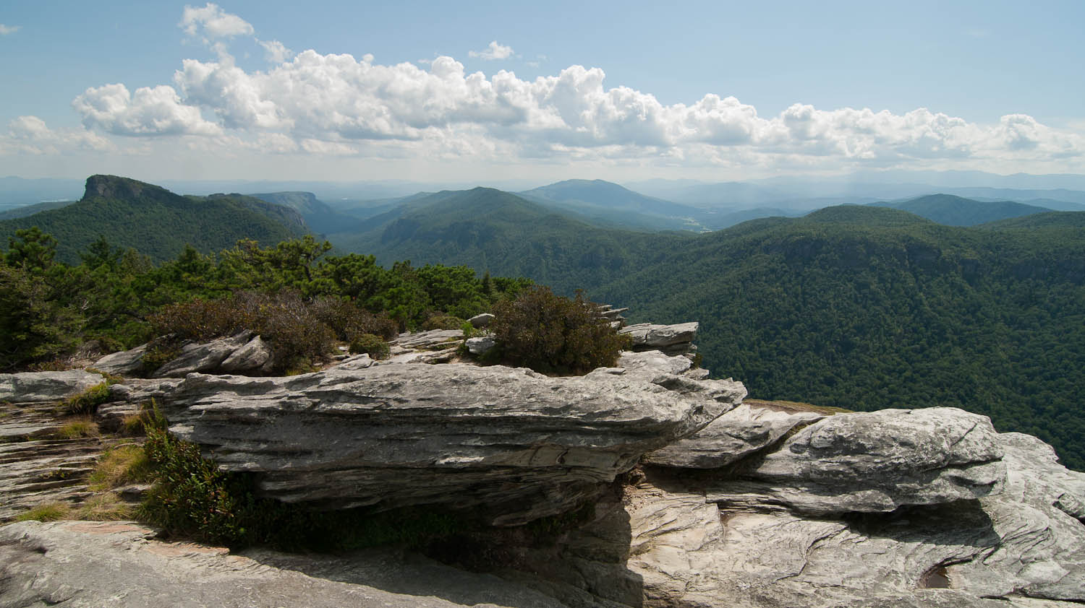
Wilderness Act of 1964
and US Forest Service Wilderness Fire Policy
Chris Ham
Regional Wilderness Program Manager
Southern Region
USDA Forest Service
cpham@fs.fed.us 404.347.2761
Photo credit: Bill Hodge
Notes:
This is an overview of the Wilderness Act of 1964 . It’s foundational and provides the legal framework for the rest of the course. You’ll here many of the terms and ideas I refer to in this section throughout the next 3 days.

Slide 2
Discussion Outline:
Use of Wilderness
Prohibited Uses
Special Provisions
USDA Forest Wilderness Policy
Preamble to Wilderness
Statement of Policy
Extent of the System
Definition of Wilderness
Agency Responsibilities
Notes:
The content will be roughly the same as the order found in the Wilderness Act. You will find a copy of the Act in your course folders. It’s the small Rite-in-the-Rain book.

Slide 3
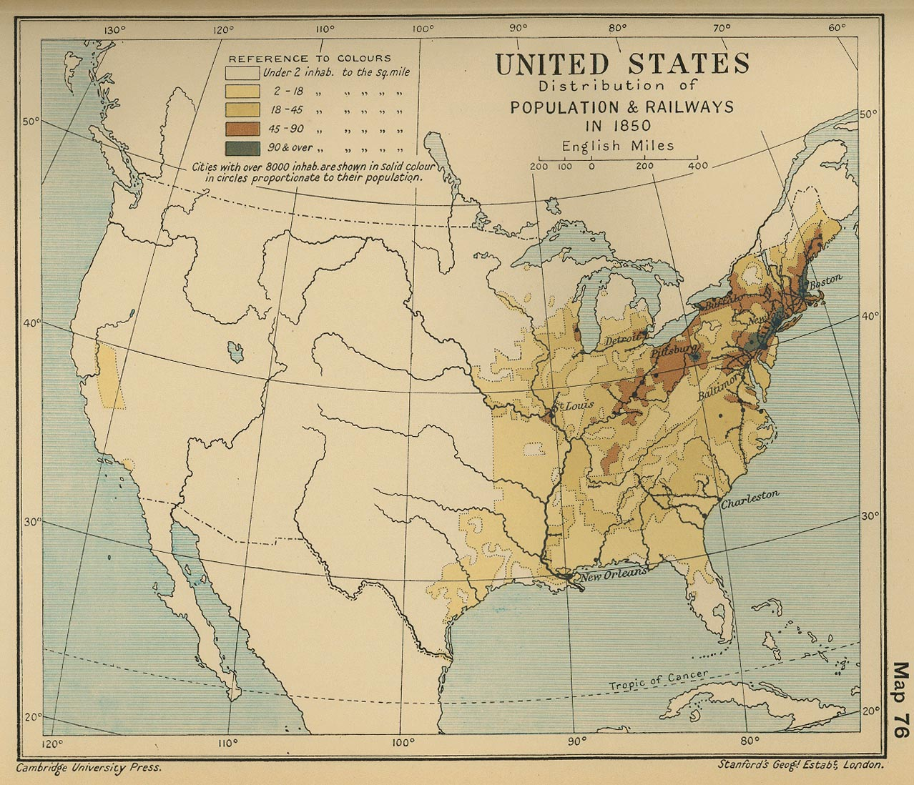
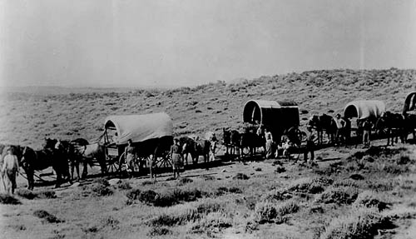
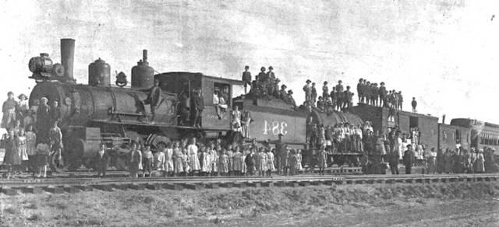
Notes:
You are all familiar with American history, but let’s set the stage for the wilderness movement. In the 19th century, we entered the era of manifest destiny which held that the US was pre-ordained to expand from the Atlantic to the Pacific. [#] The map didn’t look like this for long!

Slide 4
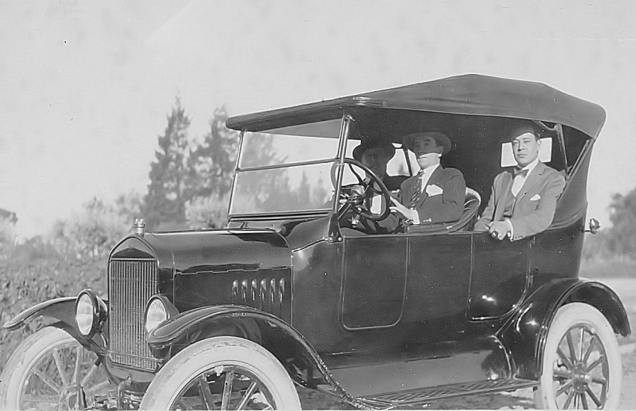
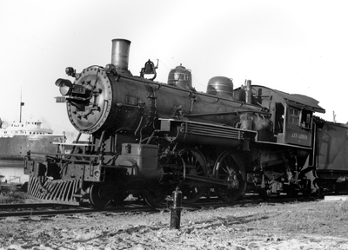
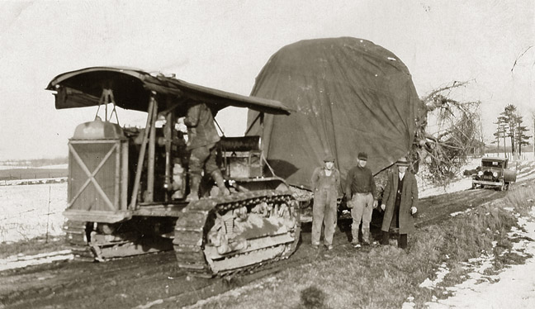
Notes:
In the early 20th Century, rapid settlement, industrialization, and the advent of the automobile, were consuming natural resources and the land itself at an astonishing rate. This was the beginning of the end for our wild lands, and it also marked the beginning of the movement to save them. The advent of the automobile, in particular, was a major impetus for the wilderness movement.
[REFERENCE: Driven Wild by Paul Sutter.]

Slide 5
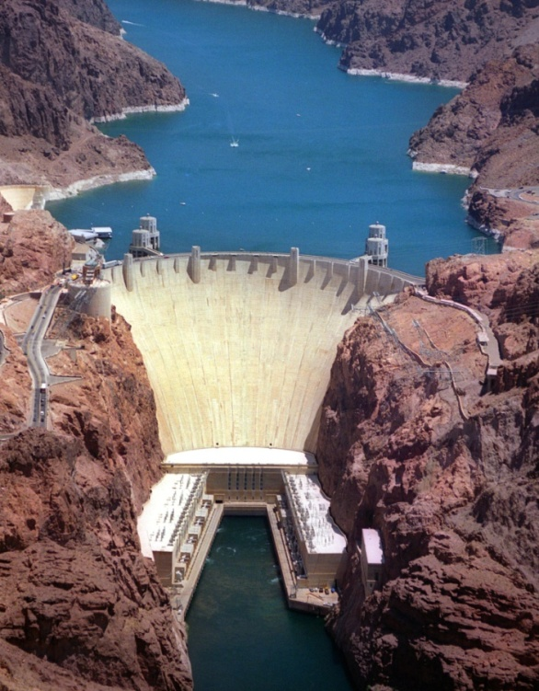
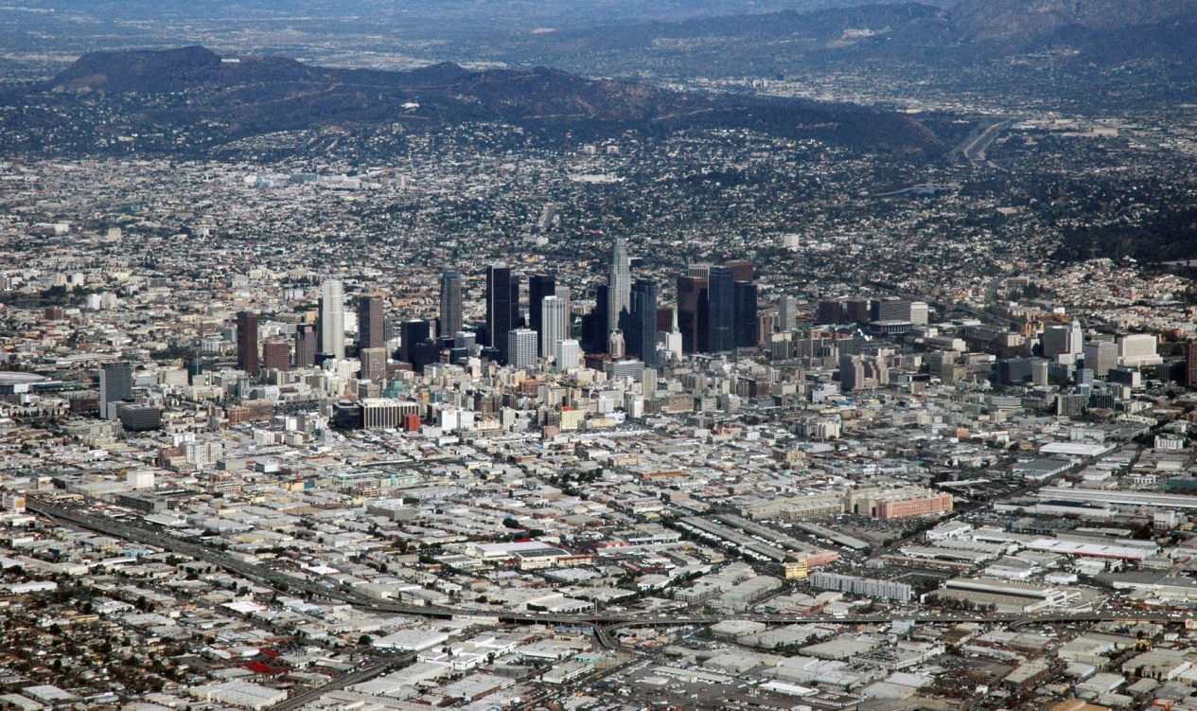
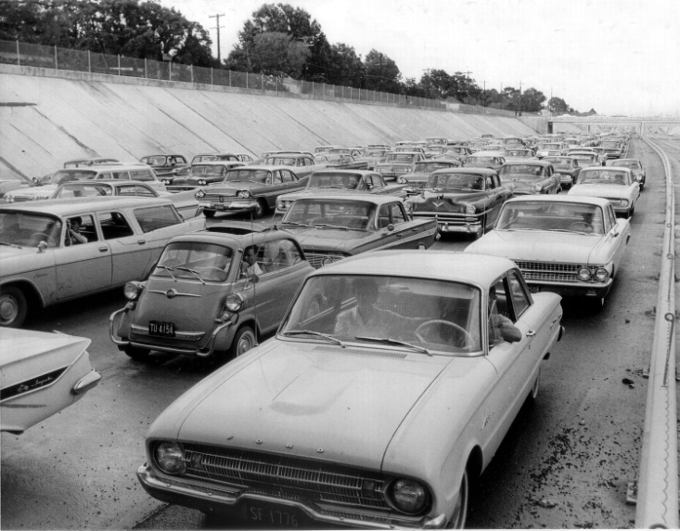
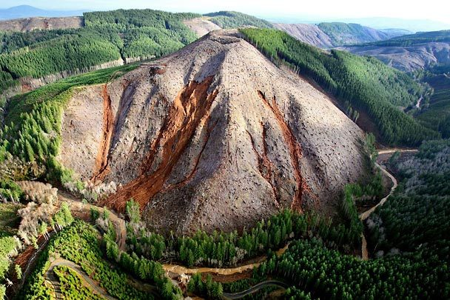
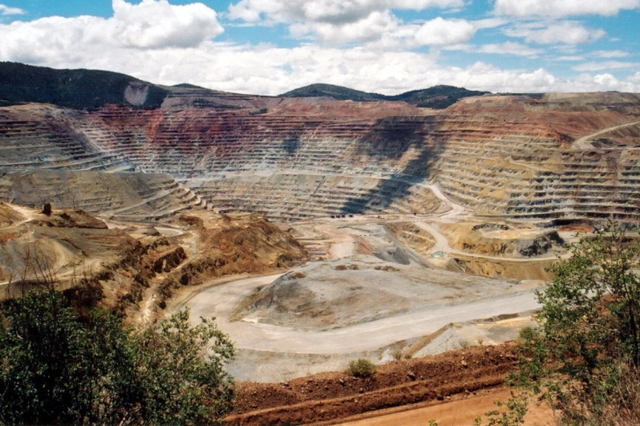
Notes:
By the 1950s, public lands were primarily seen as a source of natural resources: lumber, minerals, water, and power, fueling the juggernaut. Within just 100 years, we had altered the landscape in ways never thought possible by early generations of Americans, and many people began to fear for our remaining wildlands. Galvanized by catastrophic losses of precious places, declining environmental quality, and growing interest in preserving something of our natural heritage, the wilderness movement went mainstream.

Slide 6
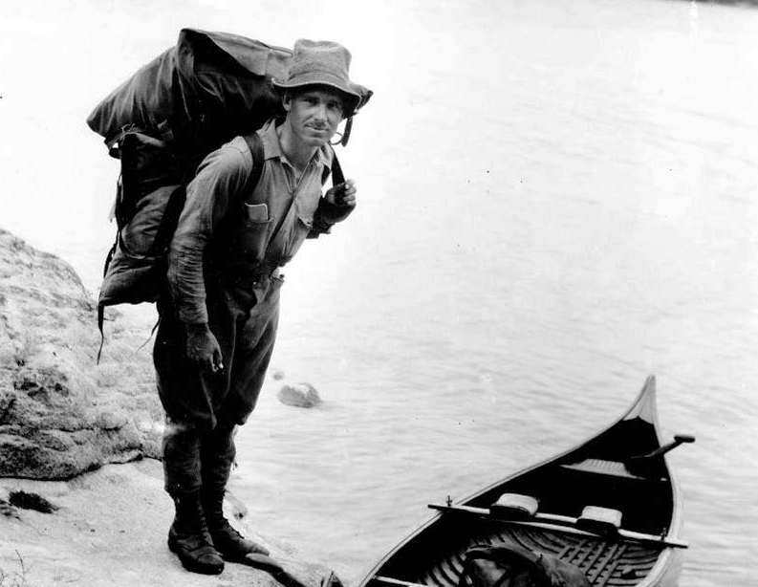
Arthur Carhart
1892-1978
Conservationist
& Landscape Architect
Notes:
All movements give rise to heros, and Arthur Carhart was the first (often unsung) hero of in the wilderness movement.
Arthur Carhart (1892-1978), our namesake, was the first to formally propose land management for purposes other than development. Carhart was the first Landscape Architect (Recreation Engineer) in the Forest Service. In 1920, he was sent to Trappers Lake, CO, on the White River National Forest to survey for roads and summer home tracts. Upon completion of his survey, he recommended the area remain undeveloped. He wrote a memo about this to Assistant District Forester Aldo Leopold, which was the first federal document to suggest the concept of wilderness. Most of the area was eventually included in the Flattops Wilderness. In 1921, Carhart made a similar recommendation for much of the area known as the Boundary Waters Canoe Area Wilderness.

Slide 7
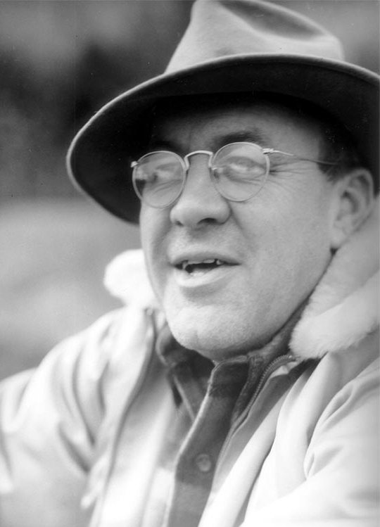
The Wilderness Society
Howard Zahniser
1906-1964
Bureaucrat & Politician
Aldo Leopold
1886-1948
Scientist, Author, & Philosopher
Bob Marshall
1901-1939
Philanthropist & Adventurer
Notes:
Carhart was soon joined by other courageous visionaries in the fight for permanent protection for our remaining wild lands under the banner of the Wilderness Society (1935).
Aldo Leopold (1887-1948) was an author, scientist, ecologist, forester, and environmentalist. He might have been the first “ecologist,” before we really understood ecology, and he founded the science of wildlife biology. But he is best known for his seminal book A Sand County Almanac, which introduced the “land ethic.” Published after his death in 1948, this book has become required reading for most college ecology courses. As an Assistant District Forester in NM in 1922, Leopold recommended the headwaters of the Gila River be preserved in its natural condition, and, in 1924, the area was administratively set aside as the first wilderness reserve in the world, later designated as the Gila Wilderness. Leopold co-founded the Wilderness Society.
Bob Marshall (1901-1939) was a wealthy philanthropist, forester, writer, and wilderness activist (and a lunatic). He was best known for his superhuman ability to hike very long distances in a single day (40 miles or more) and was one of the first to explore the Brooks Range in AK. He later co-founded (and financed) the Wilderness Society. As the first Director of Lands and Recreation in the Forest Service, Marshall wrote the U-Regulations, the first real protections for wilderness lands, 25 years before the Wilderness Act.
Howard Zahniser (1906-1964) was a career civil servant (Bureau of Biological Survey, which later became FWS) from humble roots, a dogged activist, and a talented bureaucrat. Zahniser is most noted for being the primary author of the Wilderness Act of 1964. He quit his government job to become one of the early leaders of the Wilderness Society, and he played a pivotal role in the victory against the Echo Park Dam in the 1950s. Zahniser was hopelessly dedicated to the preservation of the beloved wildlands that he rarely got to visit.

Slide 8
Wilderness Act of 1964
Finally, After:
3 decades of lobbying by the Wilderness Society
8 years of debate in Congress
66 different drafts of the wilderness bill
18 public hearings and 6,000 pages of testimony…
Congress voted nearly unanimously:
“To establish a National Wilderness Preservation System for the permanent good
of the whole people, and for other purposes.”
Notes:
Finally, after… [#####] On July 30, 1964, after passing the Senate a second time, the Wilderness Act finally passed the House with only one dissenting vote (Joe Pool, TX).
Coincidentally, this is the full title of the Wilderness Act. Section 1 of the Act establishes its short title as the “Wilderness Act.” Acts of Congress are often retitled in this manner.

Slide 9
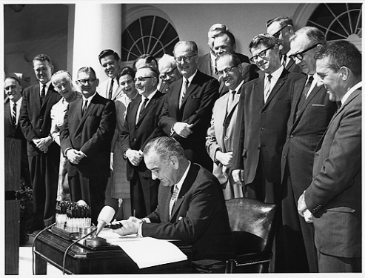
President Lyndon Johnson Signing the Wilderness Act on Sept 3, 1964
Notes:
The Act was signed into law by President Lyndon Johnson on Sept 3, 1964. We just celebrated its 50th Anniversary in ABQ, at which all four agencies recommitted themselves to the next 50 years by signing “2020 Vision,” an interagency wilderness stewardship plan for the future.
[DISCUSSION: People sometimes observe that there were no women involved in the wilderness movement. There were, in fact, and there are two of them in this photo alone. Do you know who they are? Mardy Murie (left), widow to Olaus, and Alice Zahniser (right), widow to Howard.]

Slide 10
Statement of Purpose
“…to assure that an increasing population, accompanied by expanding settlement and growing mechanization, does not occupy and modify all areas within the United States and its possessions, leaving no lands designated for preservation and protection in their natural condition…” Sec 2(a)
Notes:
What exactly did Congress intend by passing the Wilderness Act? Section 2(a) of the Act cites its purpose, which was to ensure that we do not “occupy and modify” all areas…

Slide 11
Wilderness Act of 1964
Statement of Policy
“…it is hereby declared to be the policy of the Congress to secure for the American people of present and future generations the benefits of an enduring resource of wilderness.”
Sec 2(a)
Notes:
And… [READ SLIDE #] Thus was born the National Wilderness Preservation System…
Regional Wilderness Stewardship Training
November 2011

Slide 12
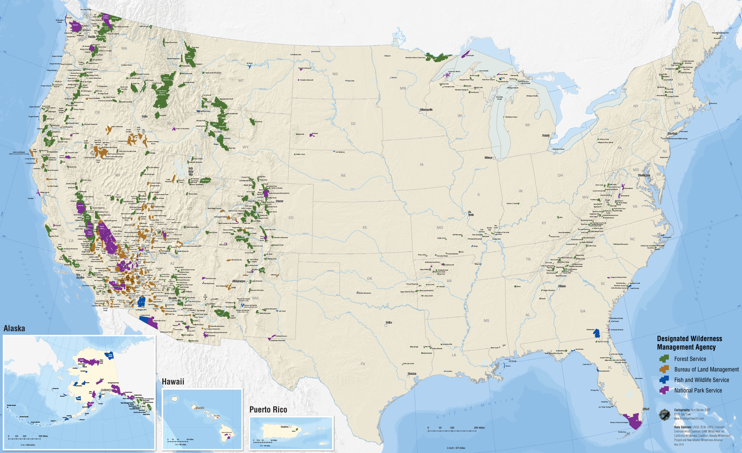
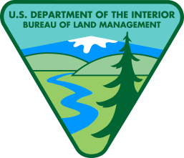
Extent of the System
NATIONAL WILDERNESS
PRESERVATION SYSTEM
1964
9.1 Mil Acres
54 Wilderness Areas
2017
109.12 Mil Acres
765 Wilderness Areas
Notes:
The Wilderness Act was not to be the end, but the beginning. In addition to establishing the NWPS, the Act prescribes a process for future designations. Congress intended the System to grow, and it has. [#] This looks like a lot of land, but it’s really only 5% of the US, and over half of it is in AK. The total area of currently designated is about the size of CA.
Do you know what the smallest wilderness is? [# Pelican Island @ 6 acres]. How about the largest wilderness? [# Wrangell-St. Alias @ over 9 mil acres].
Are there any states without wilderness? (There are six.) Which agency manages the most wilderness areas? (FS) Which manages the most acres? (NPS)

Slide 13
Definition of Wilderness
?
“A wilderness, in contrast with those areas where man and his own works dominate the landscape…” Sec 2(c)
Notes:
Since we now have almost 110 million acres of it, we need to know what it is. How do you define wilderness? “Wilderness is a dark and dismal place where all manner of beasts roam around uncooked.” -- Anonymous. “The essence of wilderness is big mammals that can eat you.” -- Abbey. There are many different ways to define wilderness, so Congress defined it for us. [#]
Section 2(c) of the Act, “Definition of Wilderness,” defines wilderness as a place… Wilderness is different from other lands we manage and it must be managed differently to maintain this contrast. If we dummy it down, it loses it’s power. Wilderness is the only place where visitors are promised, by law, the opportunity to escape the grasp of modern human civilization (to the greatest degree possible).

Slide 14
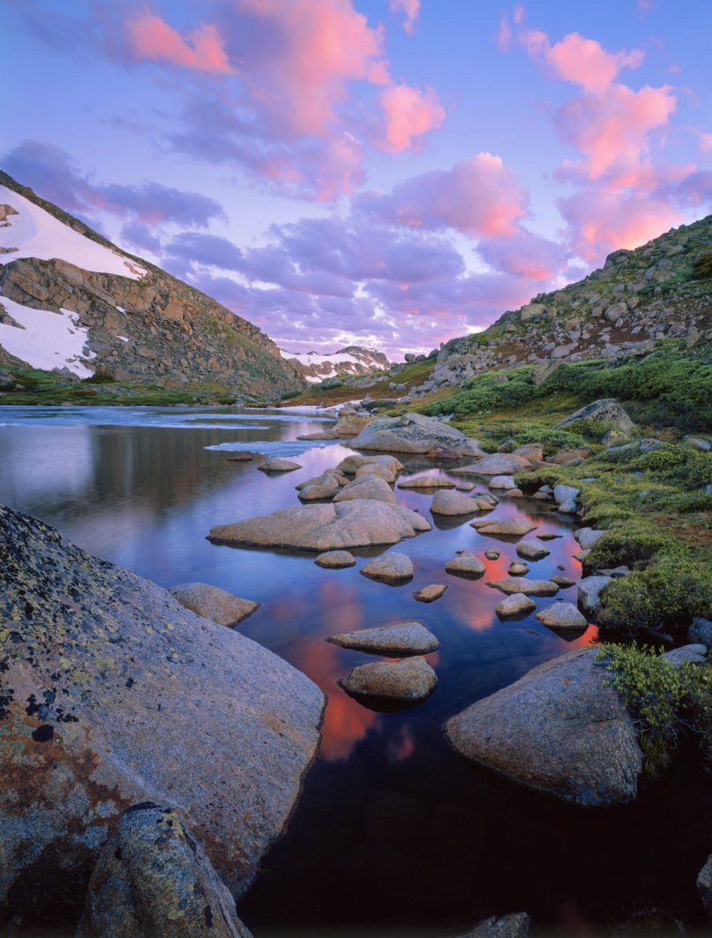
Definition of Wilderness
“…an area where the earth and its community of life are untrammeled by man, where man himself is a visitor who does not remain.” Sec 2(c)
“…undeveloped Federal land retaining its primeval character and influence, without permanent improvements or human habitation…” Sec 2(c)
Notes:
The definition of wilderness has six key parts… [#] Note the emphasis placed on the words in bold – the importance of these words will become apparent in a few minutes.

Slide 15
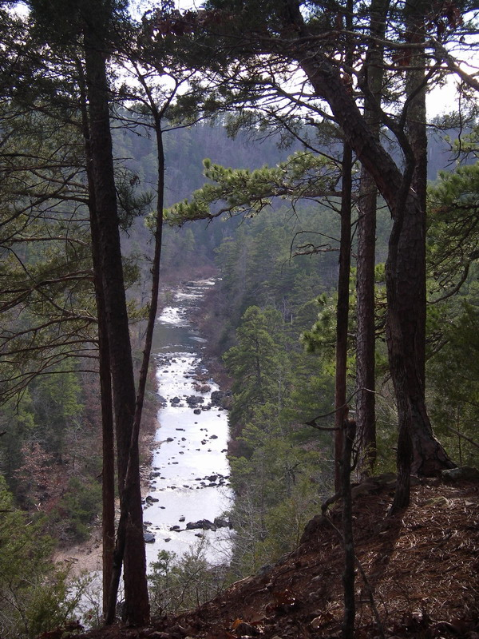
Definition of Wilderness
“…generally appears to have been affected primarily by the forces of nature, with the imprint of man’s work substantially unnoticeable…”
“…has outstanding opportunities for solitude or a primitive and unconfined type of recreation…”
Notes:
[## READ SLIDE]

Slide 16
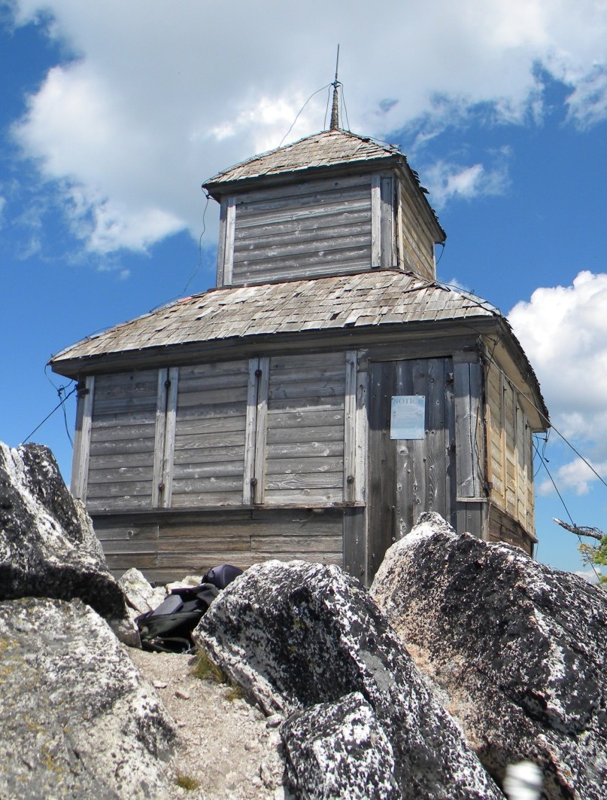
Definition of Wilderness
“…has at least five thousand acres of land or is of sufficient size as to make practicable its preservation and use in an unimpaired condition…”
Sec 2(c)
“…may contain ecological, geological, or other features of scientific, educational, scenic, or historical value.” Sec 2(c)
Notes:
[#]

Slide 17
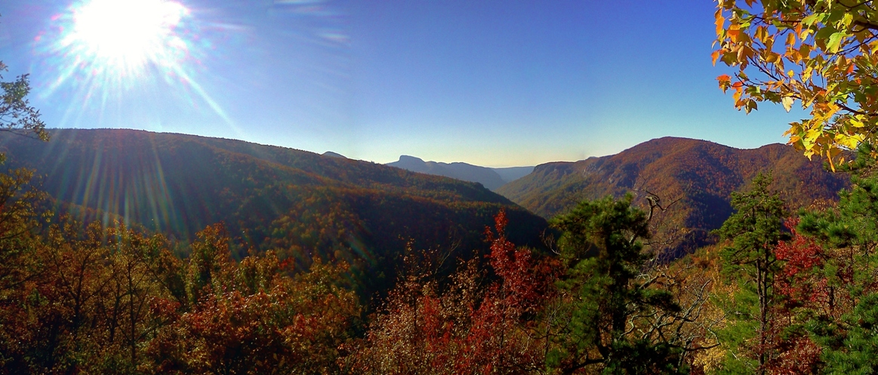
Agency Responsibilities
“… these [areas] shall be administered for the use and enjoyment of the American people in such manner as will leave them unimpaired for future use and enjoyment as wilderness, and so as to provide for the protection of these areas, the preservation of their wilderness character.”
Sec 2(a)
Notes:
Now that we know what Congress intended wilderness to be, how do we honor that? Naturally, Congress told us how to do that too. Section 2(a) lays it out for us in general terms… [READ SLIDE]
Regional Wilderness Stewardship Training
November 2011

Slide 18
Agency Responsibilities
“… each agency administering any area designated as wilderness shall be responsible for preserving the wilderness character of the area and shall so administer such area for such other purposes for which it may have been established as also to preserve its wilderness character.” Sec 4(b)
Notes:
And, just in case you missed it the first time, the Act states twice more in Section 4(b) that we must preserve wilderness character. How important is this? There have been 287 suits involving wilderness character!
Regional Wilderness Stewardship Training
November 2011

Slide 19
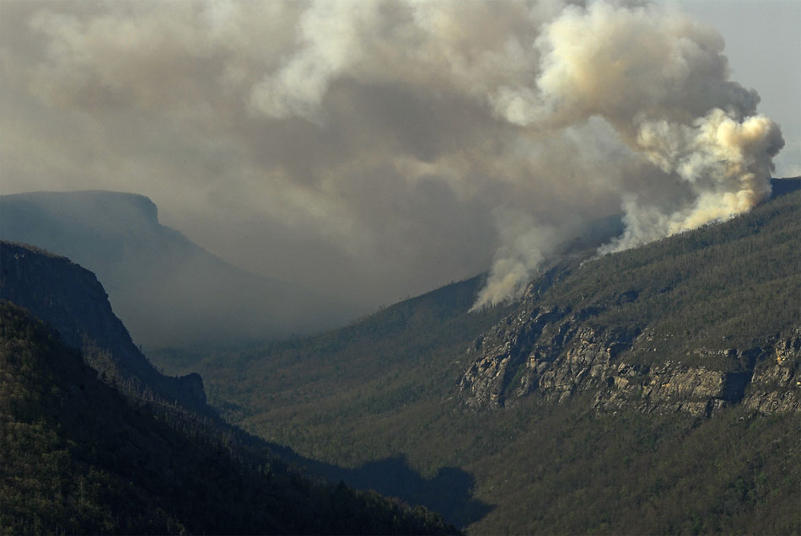
Qualities of Wilderness Character
Untrammeled
Wilderness is essentially unhindered and free from the actions of modern human control or manipulation.
Notes:
[READ SLIDE]
Regional Wilderness Stewardship Training
November 2011

Slide 20
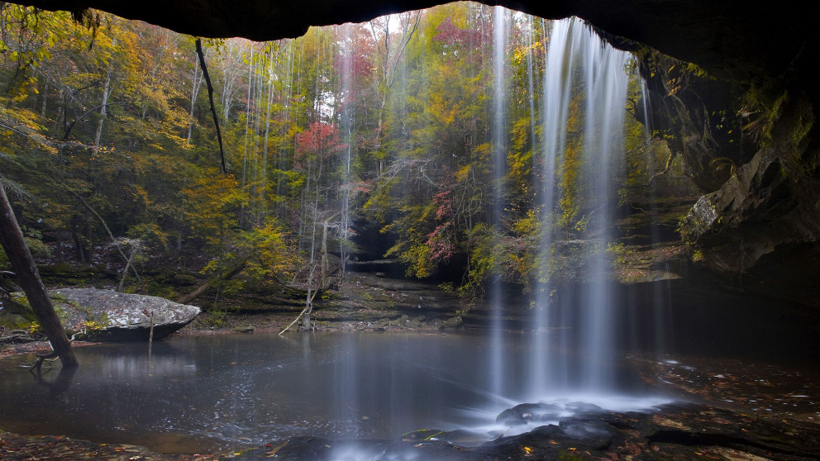
Qualities of Wilderness Character
Undeveloped
Wilderness retains its primeval character and influence and is essentially without permanent improvement or modern human occupation.
Notes:
[READ SLIDE]
Regional Wilderness Stewardship Training
November 2011

Slide 21
Qualities of Wilderness Character
Natural
Wilderness ecological systems are substantially free from the effects of modern human civilization.
Notes:
[READ SLIDE]
Regional Wilderness Stewardship Training
November 2011

Slide 22
Qualities of Wilderness Character
Outstanding Opportunities
Wilderness provides outstanding opportunities for solitude or primitive and unconfined recreation.
Notes:
[READ SLIDE]
Regional Wilderness Stewardship Training
November 2011

Slide 23
Qualities of Wilderness Character
Unique/Other Features
Wilderness preserves unique attributes or other features that reflect the character
of a specific wilderness.
Notes:
[READ SLIDE]
Regional Wilderness Stewardship Training
November 2011

Slide 24
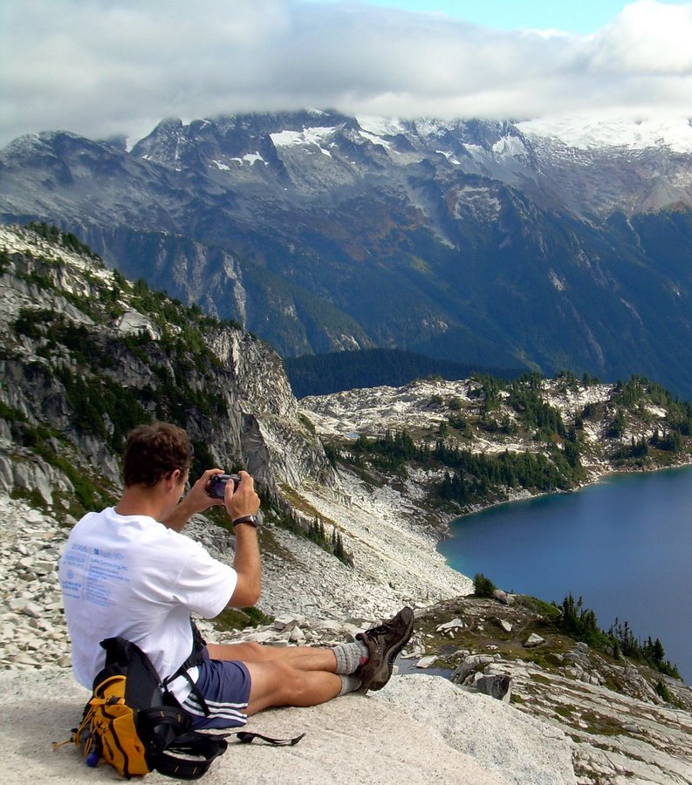
Use of Wilderness
“Except as otherwise provided in this Act, wilderness areas shall be devoted to the public purposes of recreational, scenic, scientific, educational, conservation,
and historical use.”
Sec 4(b)
Notes:
[READ SLIDE] These are known as the “public purposes” of wilderness. Does this look like a comprehensive list of wilderness values? [#] Are there others? (Economic, spiritual, etc) These are protected too…
Regional Wilderness Stewardship Training
November 2011

Slide 25
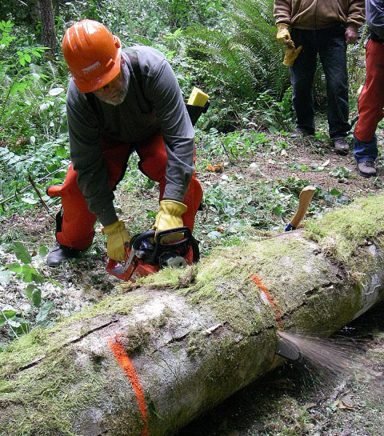
Prohibited Uses
Commercial Enterprise
Permanent Road
Temporary Road
Use of Motor Vehicles
Motorized Equipment
Motorboats
Landing of Aircraft
Mechanical Transport
Structure or Installation
Sec 4(c)
Notes:
To ensure wilderness character is preserved, some uses are explicitly prohibited… [READ SLIDE]
Regional Wilderness Stewardship Training
November 2011

Slide 26
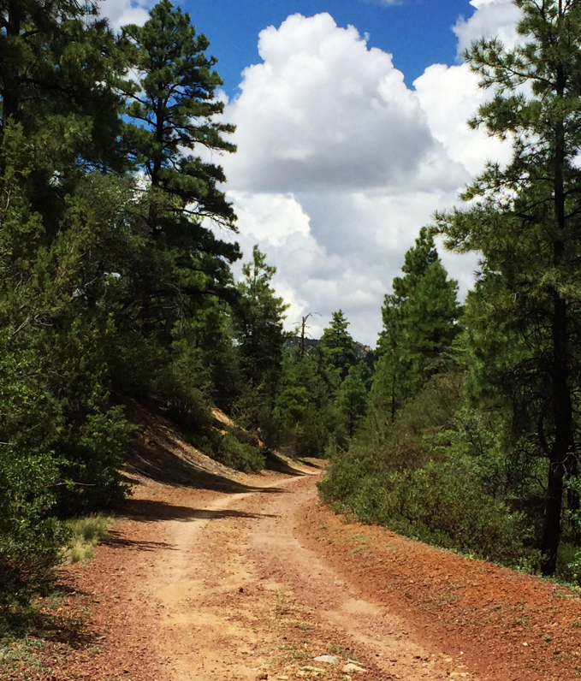
Prohibited Uses
Exceptions:
1) “Except as specifically provided for in this Act…”
2) “…subject to existing private rights…”
3) Other provisions of law
OR…
Notes:
All of the prohibited uses can be exempted in one of 3 ways: [#] 1) special provision of the Wilderness Act, [#] 2) an existing private right, or [#] 3) another Federal law. [#] And there is a 4th way by which most (8/10) of the prohibited uses can be exempted…

Slide 27
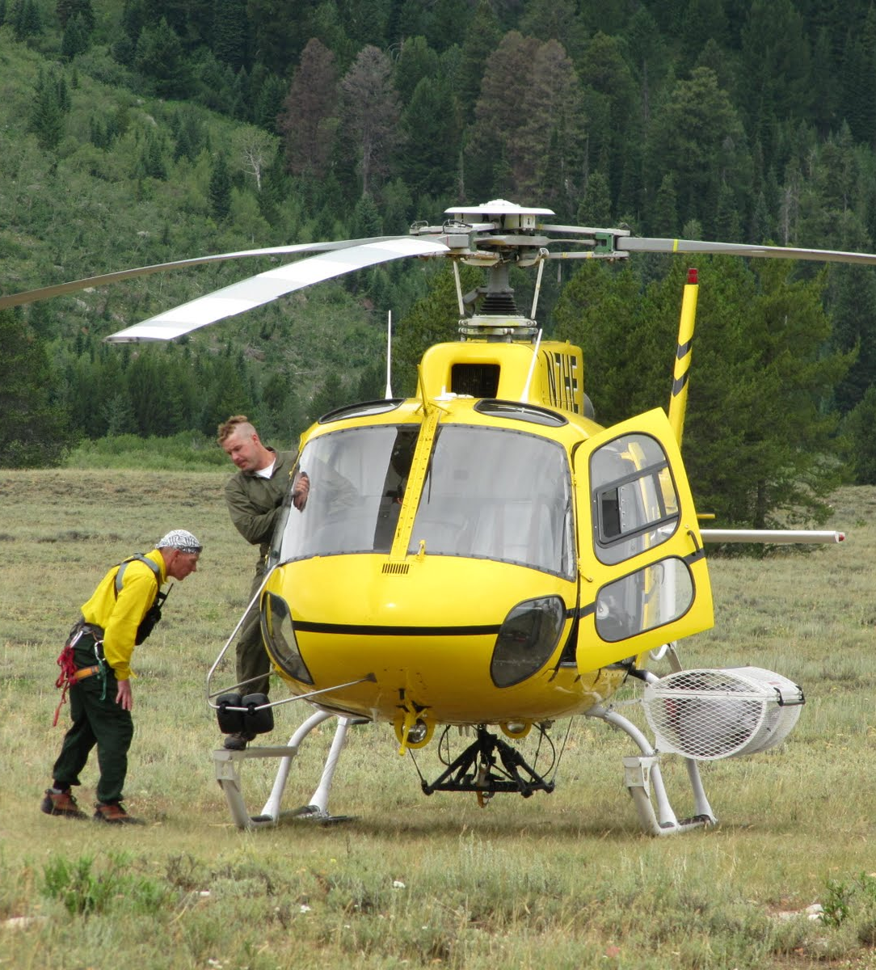
Prohibited Uses
Exceptions:
4) “…except as necessary to meet minimum requirements for the administration of the area for the purpose of this Act…” Sec 4(c)
MRA
Notes:
If it is “necessary to meet the minimum requirements for the administration of the area for the purpose of this Act.” [#] This is the genesis of the “minimum requirements analysis.”
But, all of the prohibited uses can be exempted by special provision of the Wilderness Act, an existing private right, or subsequent legislation. These are the only ways permanent roads and commercial services, may be exempted. [#] The other 8 prohibited uses, the ones we deal with most often, can also be exempted if we can demonstrate that it is both necessary to the administration of the area as wilderness and the minimum activity. This is where a “minimum requirements analysis” comes in, which we’ll talk much more about later during one of the breakout sessions.

Slide 28
Forest Service Manual 2320 Wilderness Management
Management of Fire - The objectives of fire management in wilderness are to:
Permit lightening fires to play, as nearly as possible, their natural ecological role in wilderness
Reduce to an acceptable level, risks & impacts within and outside of wilderness
(2324.21)

Slide 29
FSM 2320
Preference to methods & equipment causing least alteration & disturbance (2324.23)
Allow motorized equipment & mechanized transport only in emergencies with “unescapable urgency” and “temp need for speed” (2326.1)

Slide 30
FSM 2320
Protect Wilderness Character (2320.2)
Know special provisions in establishing legislation – some allow for non-conforming uses
Use interdisciplinary skills/expertise
Manage/inform visitors and public
(2320.3)

Slide 31
] Wilderness Fire Mgt Approach
Critical natural process, integral part of fire-adapted ecosystems
Restraint: fire mgt actions can degrade Wilderness Character
(Particularly Natural and Untrammeled)

Slide 32
] Wilderness Fire Mgt Approach
All natural fires in wilderness areas are managed
Response depends on:
Firefighter and Public Safety
Wilderness Character
Other Values- resource, social
Available Resources
Cost and Convenience Not a Driver

Slide 33
] Wilderness Fire Mgt Approach
Resource Benefits include:
Diverse Vegetation
Resilient Forest and Grassland Systems
Quality Habitats for wide-range of species
Wilderness Character Qualities Preserved
Each natural fire is an opportunity for Benefit!

Slide 34
Wilderness Fire Mgt Approach
Impacts include:
Smoke
Soil, Water, other Resource Effects
Visitors and Outfitters Displaced
Threat to Homes and Property
Public Support Reduced

Slide 35
Wilderness Fire Mgt Approach
Select methods causing least alteration & disturbance. Ask: Is this the Minimum Necessary to Manage this fire?
How Necessary is Necessary?
If Necessary, what is the Minimum Tool (method) to get this job done?

Slide 36
Wilderness Fire Mgt Approach
Dynamic and Flexible:
Resource objectives and management response can be varied on the same fire and change over time
Trigger Points/Contingencies
Prepare for Long Duration Fires

Slide 37
Wilderness Fire Mgt Approach
Resources/Tools Available Include:
Land Management Plan
Unit Fire Management Plan
Wilderness Plan
Local Wilderness Managers Letters of Delegation
Letters of Leaders Intent
Pre/Post-Season Reviews

Slide 38
Wilderness Fire Mgt Approach
Resources (continued)
Wilderness.net Fire Toolbox: including:
Fire Mgt Planning Checklist
READ Guides
(include MIST & Other Resource Protection Guidelines)

Slide 39
Wilderness Fire Mgt Approach
Beware of Risks Transferred or Deferred-
Deferral of Fire Can Mean Larger Impacts Later
Look Hard at “Exposure”

Slide 40
Wilderness Fire Mgt Approach
New Wilderness Performance Measures:
Accountable for:
Acres in Wilderness Burned (relative to established historic amounts)
Continue to report motorized- mechanized-aircraft landing/drops

Slide 41
Wilderness Fire Mgt Approach
50th Anniversary:
Debate about Wilderness Fire- Too Much or Too Little?
Impacts Acceptable?
Conditions are Important Focus
What About Trammeling?

Slide 42
Preserve Wilderness Character For Present & Future Generations

Slide 43
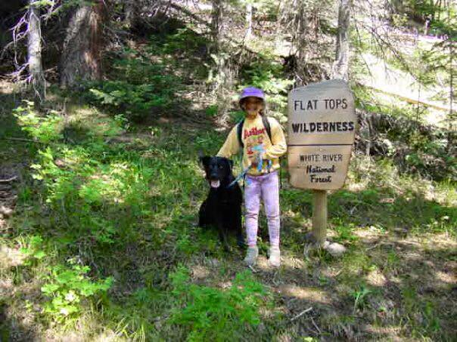
Wilderness: An Enduring Resource

